Slide 1

Music & Mental Health EDA
Deepanshi

Slide 2
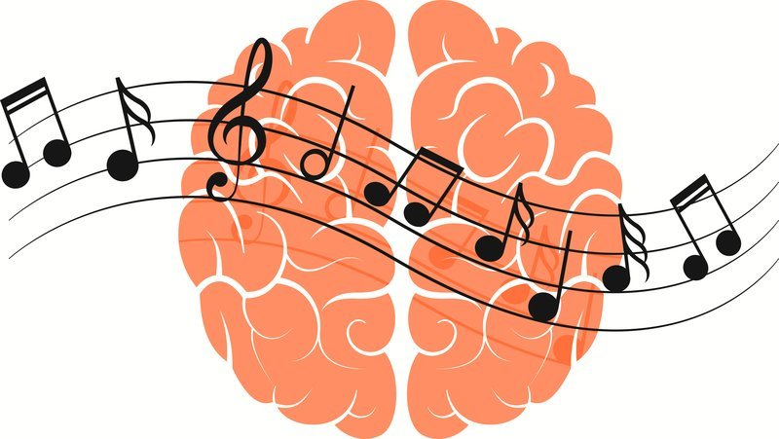
Data set
Music & Mental Health Survey data
Kaggle - https://www.kaggle.com/code/catherinerasgaitis/music-mental-health-eda/data
Size – (736, 33)
Columns - ['Timestamp', 'Age', 'Primary streaming service', 'Hours per day',
'While working', 'Instrumentalist', 'Composer', 'Fav genre',
'Exploratory', 'Foreign languages', 'BPM', 'Frequency [Classical]',
'Frequency [Country]', 'Frequency [EDM]', 'Frequency [Folk]',
'Frequency [Gospel]', 'Frequency [Hip hop]', 'Frequency [Jazz]',
'Frequency [K pop]', 'Frequency [Latin]', 'Frequency [Lofi]',
'Frequency [Metal]', 'Frequency [Pop]', 'Frequency [R&B]',
'Frequency [Rap]', 'Frequency [Rock]', 'Frequency [Video game music]',
'Anxiety', 'Depression', 'Insomnia', 'OCD', 'Music effects',
'Permissions']

Slide 3
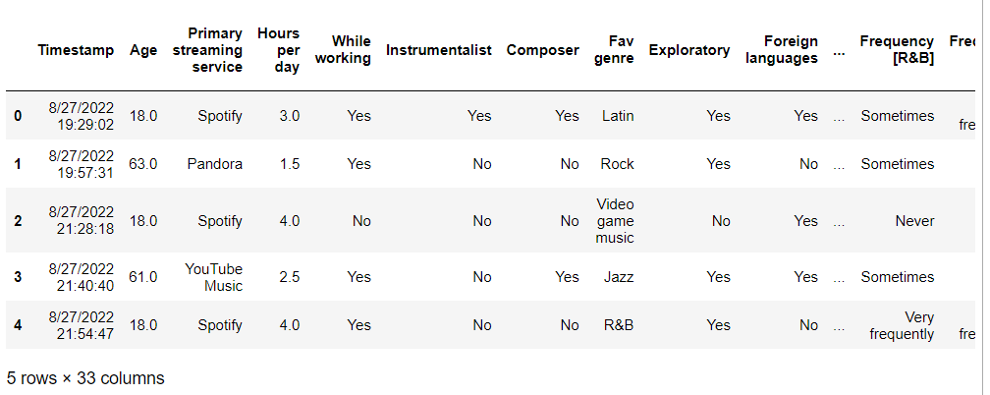

Data Exploration
Importing libraries and reading data from csv.

Slide 4
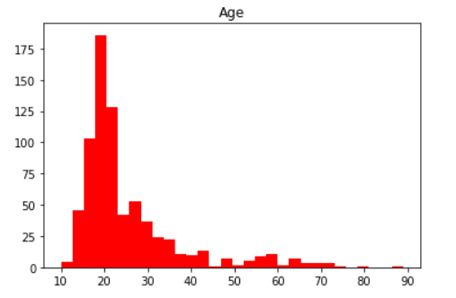
Respondent’s Background
Age distribution of respondents.

Slide 5
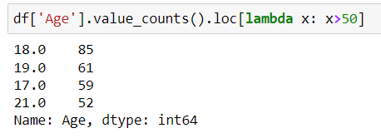

Most Aged listener
Maximum Number of song listener by age
Most respondents are in their late teens or early twenties. A single 89 year old respondent is an interesting outlier!

Slide 6

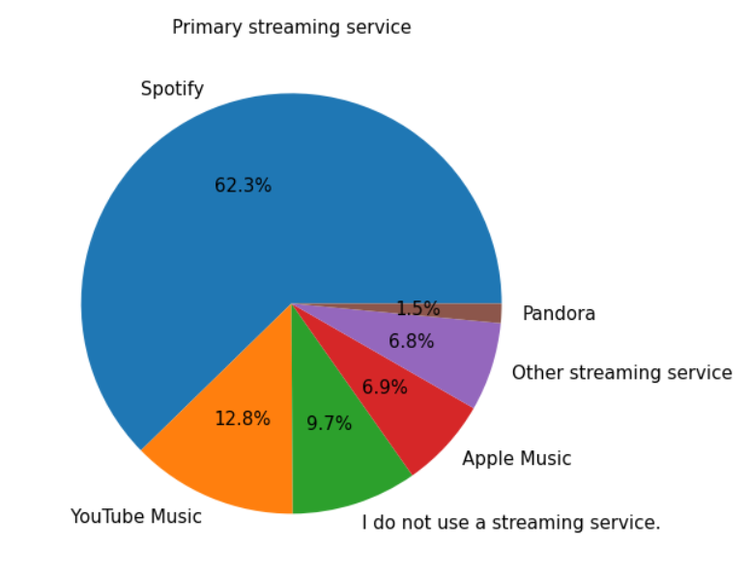
Streaming services respondents are using

Slide 7
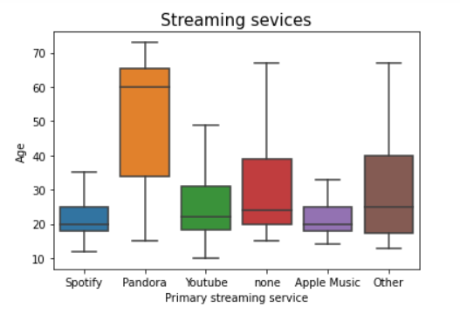
Age distribution of Streaming services

Slide 8
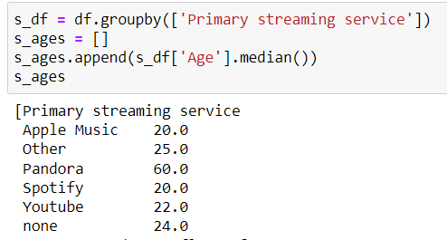
Median of Age by streaming services
Spotify is the most popular music streaming service, accounting for 62% of all respondents. Spotify, along with Apple Music, also has a marginally younger user base than other streaming platforms. Pandora has the oldest user base by far, with the median user age at ~60 years old.

Slide 9
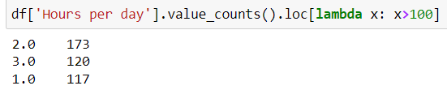
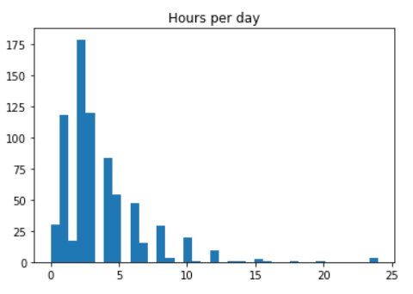
Respondent listen music time(hr) per day
The vast majority of respondents listen to music between 0-5 hours per day.
After this threshold, the number of respondents that listen to music 5+ hours a day decreases almost exponentially.
There are a few respondents that claim to listen to music 24 hours a day.

Slide 10
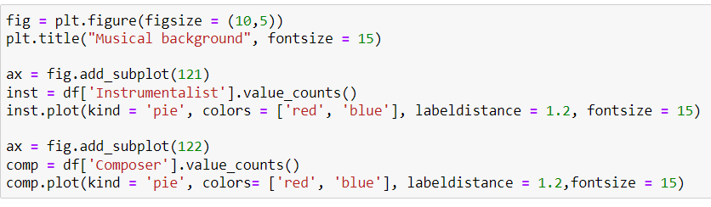
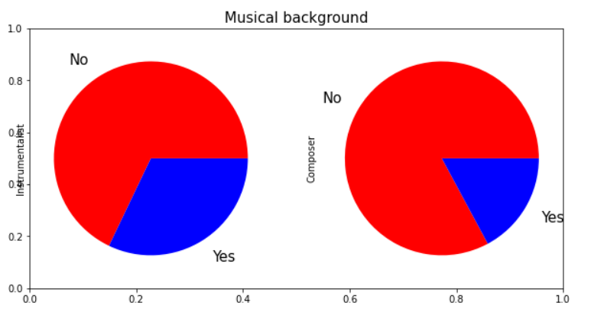
Instrumentalist and composer

Slide 11
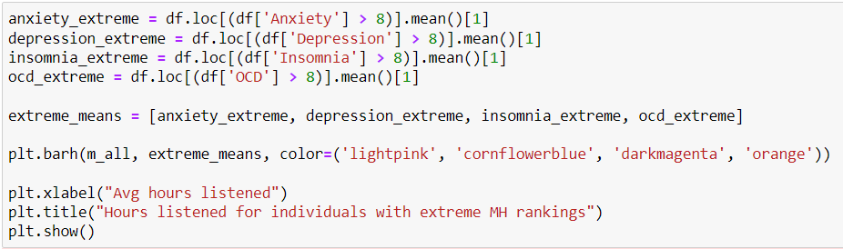
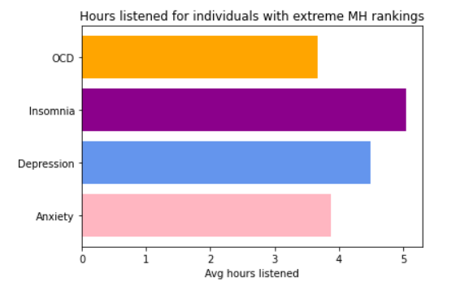
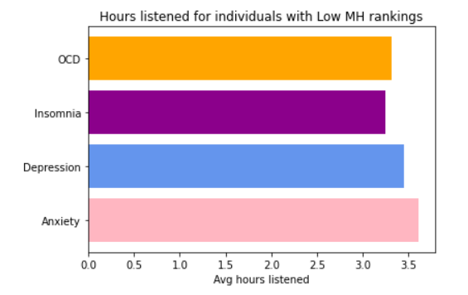
Disorder based listeners per day
Individuals with extreme OCD have a slightly lower listening time.

Slide 12
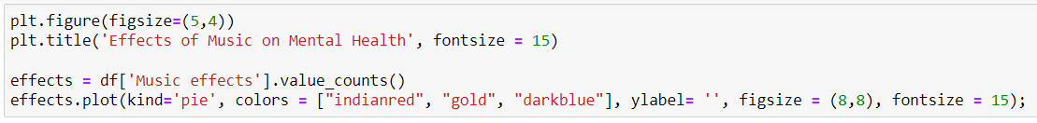
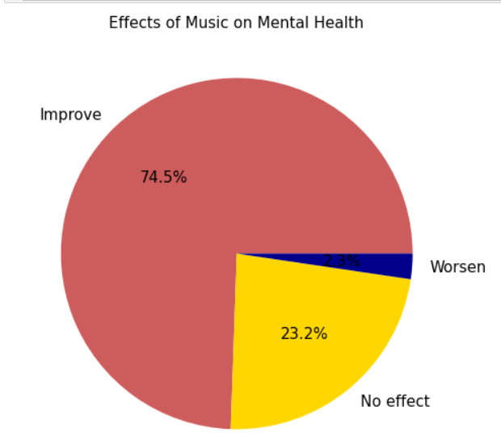
Effect of music on mental health
The majority of respondents find that music has a positive impact on their mental health.

Slide 13
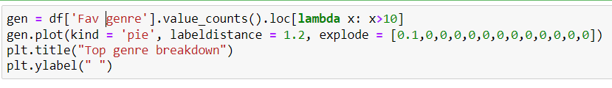
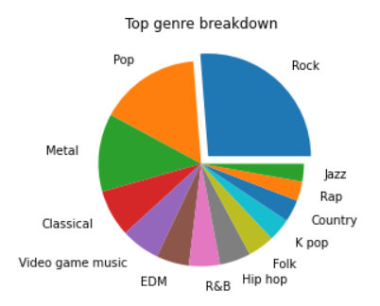
Favourite Genre
Rock is the most popular genre, being selected as an individual's favorite genre 1 out of 4 times.

Slide 14
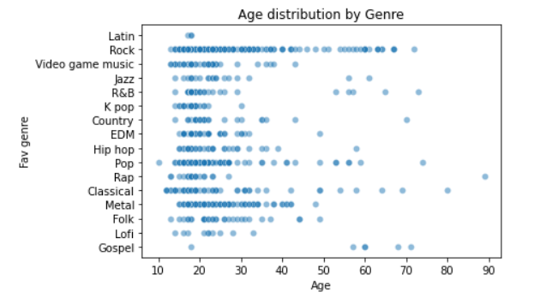
Fav genre by Age plot
Rock has the most diverse range of ages.
Classical and Pop listeners also have a wider range of ages compared to other genres.
Some music genres, such as K pop and Lofi appear to attract a more specific and younger age group.

Slide 15
Thank you!!

